Slide 1
Lab3 : a LSTM Cell for Image Captioning
補充
Department of Computer Science, NCTU
TA Ziv(鍾嘉峻)

Slide 2
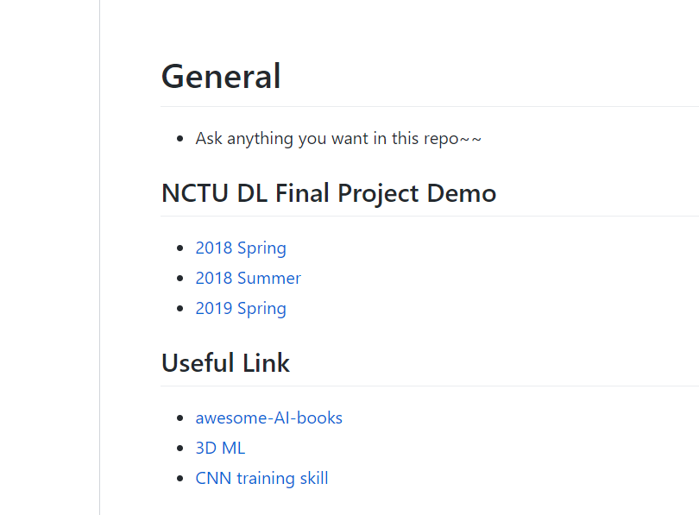
Useful Link

Slide 3
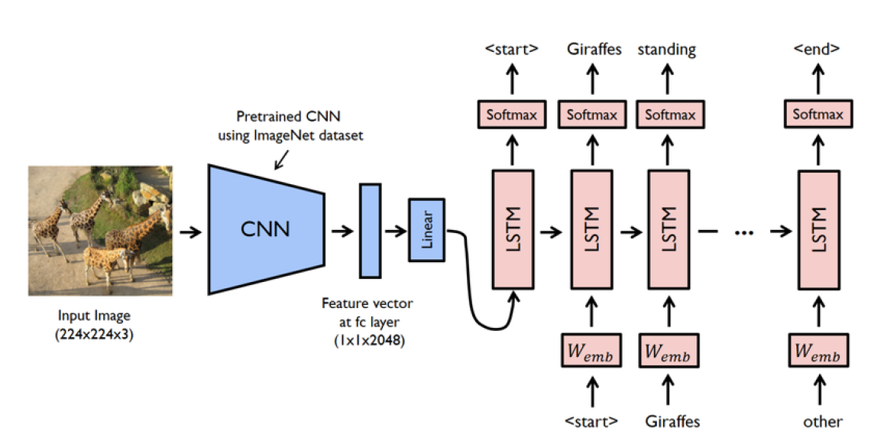
Image-Caption

Slide 4
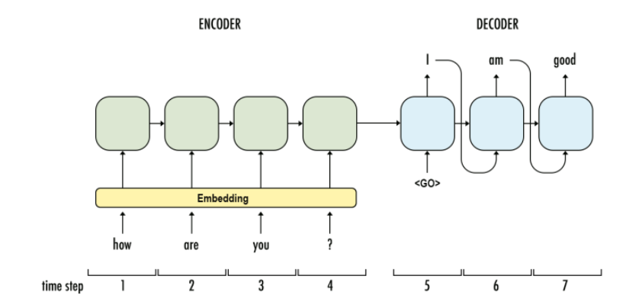
Encoder-Decoder

Slide 5
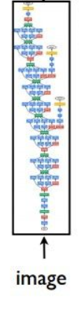
Encoder-Decoder
Show and Tell: A Neural Image Caption Generator

Slide 6
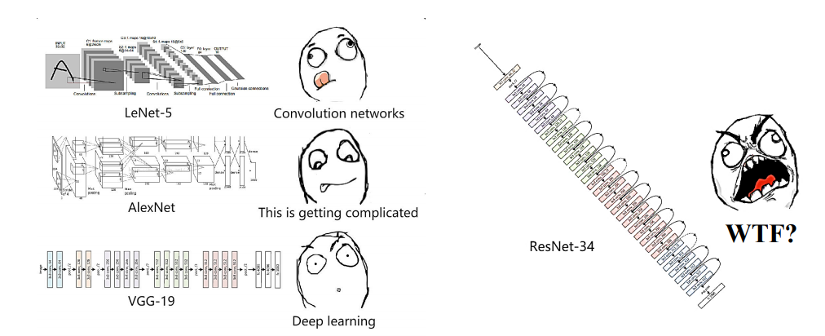

Encoder
Using pretrain models to extract feature vector from a given input image
Using pretrained ResNet-152
From Torchvision
ResNet-152

Slide 7
Pretrained ResNet-152
Pretrained on the ILSVRC-2012-CLS
Delete the last fc layer, use NEW linear layer to transform feature vector to have the same dimension as the input dimension of the LSTM network

Slide 8
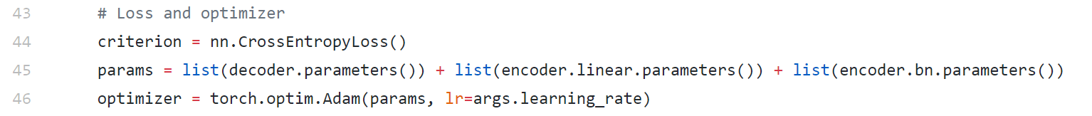
Parameters Update
In train.py Line 45 ~ 46
ResNet part parameters won’t update

Slide 9
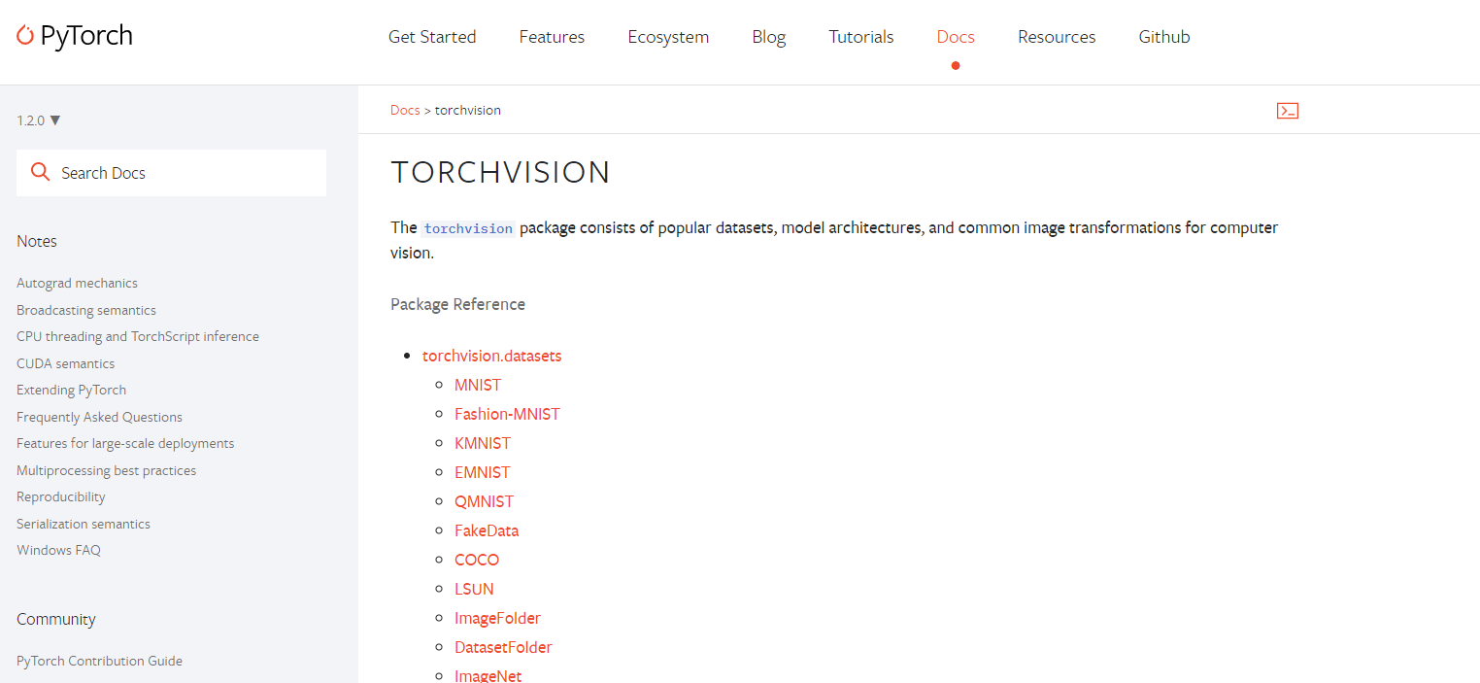
Torchvision
Pytorch official package consists of
popular datasets
model architectures
common image transformations for computer vision.

Slide 10
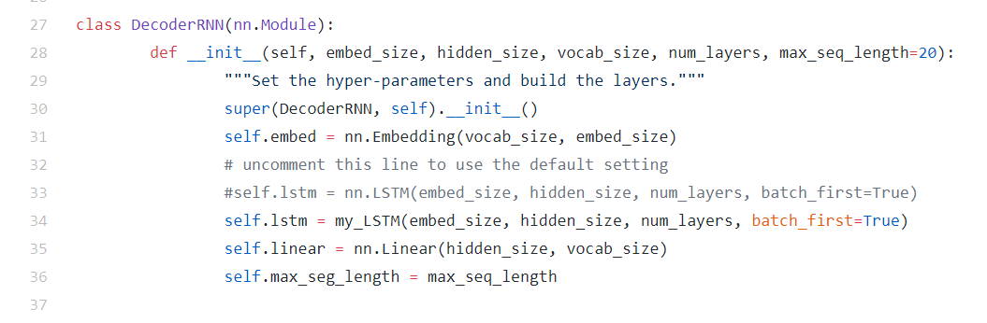
Decoder
Noticed that you will use your model in model.py line 34
You can use nn.LSTM to check your environment is OK or not

Slide 11
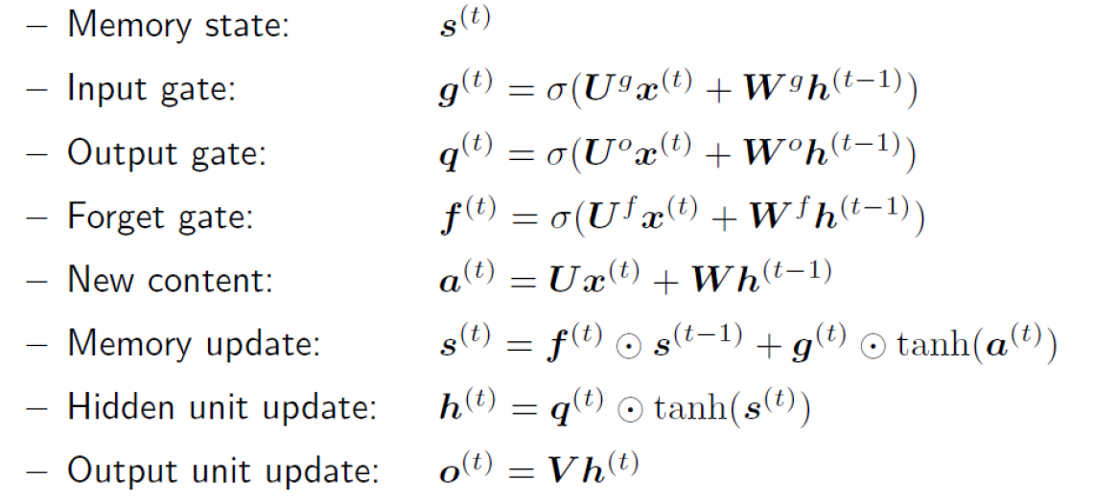
LSTM Recall
At professor slide “RecurrentNeuralNetworks.pdf”

Slide 12
Lstm Implement Hint
You can use nn.Linear to build your lstm
RNN Example

Slide 13
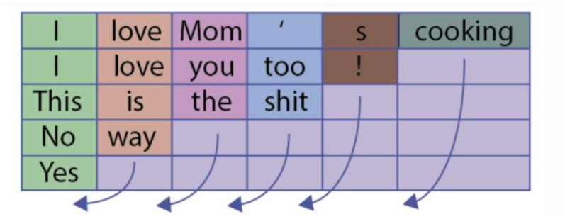
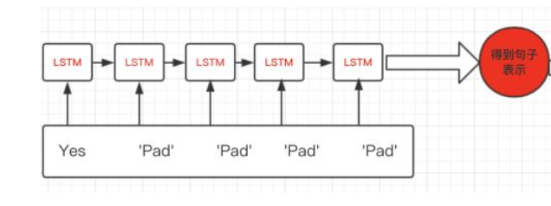
pack_padded_sequence

Slide 14
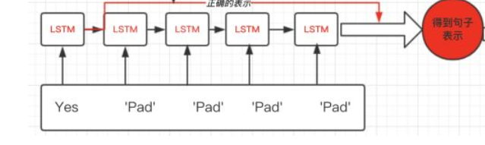
pack_padded_sequence

Slide 15
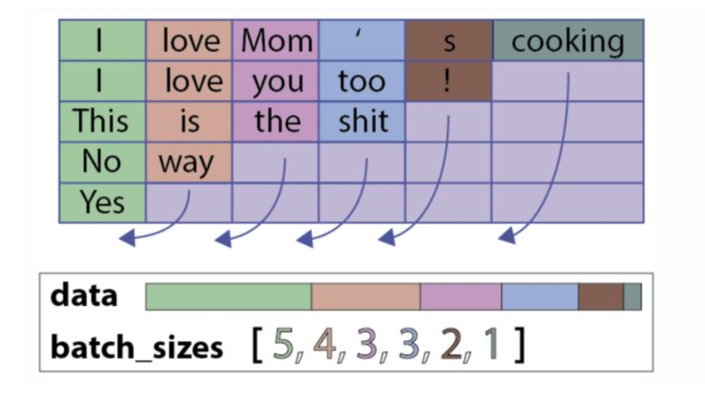
pack_padded_sequence

